Slide 1
Predicting Weather Caused Train Delays Finnish Meteorological Institute Roope Tervo

Slide 2

We aim to predict disruption of rail traffic caused by weather
Project
Problem restricted strictly to weather – delays of other trains are not considered in prediction
Project timeline: 01/2018-10/2018
Project partners: IL, LiVi, Trafi, VR
Area: Finland
Time range: 2 days ahead Time step: 1 hour
Notes:
Clients are about to get new online train delay forecasting system
Message: Our target is to predict disruption of rail traffic caused by weather

Slide 3
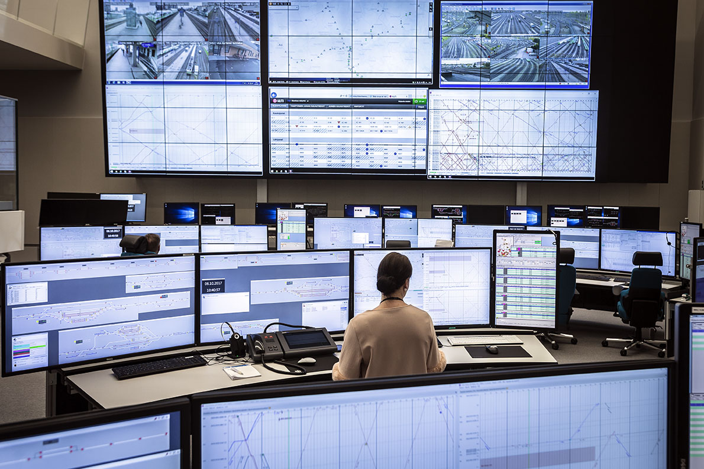
Image: Solita Oy
Notes:
Message: motivation for the work is to be able to provide a tool for the rail traffic operation center
They can take actions: put more workforce on field, reduce train shifts
Communications is also important for pr

Slide 4
Target is to provide a tool for the rail traffic operation center
Operation center can take several actions:
Get more workforce
Reduce train shifts
Communicate
Image: Solita Oy
Notes:
Message: motivation for the work is to be able to provide a tool for the rail traffic operation center
They can take actions: put more workforce on field, reduce train shifts
Communications is also important for pr

Slide 5
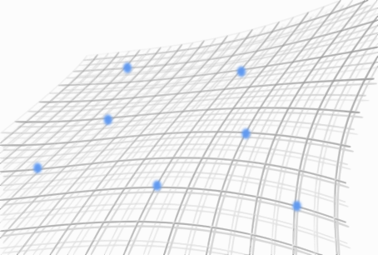
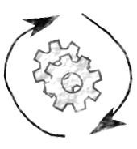
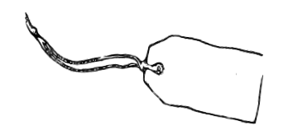
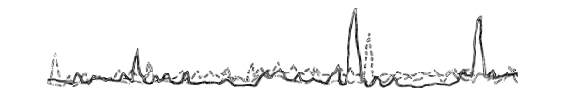
Method
+
Label data
Feature data
Results

Slide 6
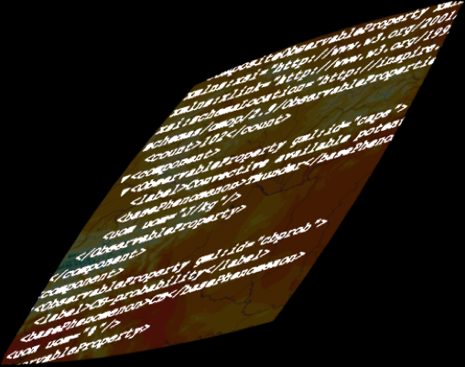
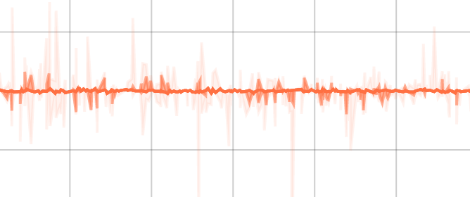
Method
+
NWP
Results

Slide 7
Method
+
Label data
Feature data
Results
+
NWP
Method
Prediction

Slide 8
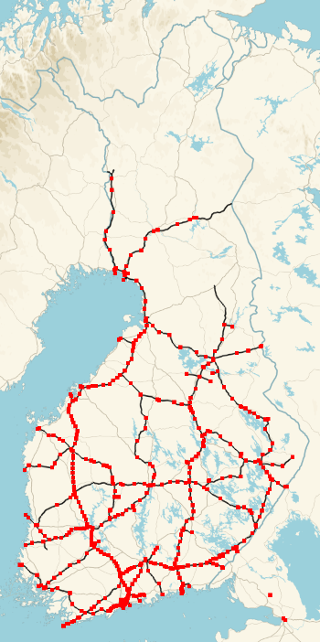
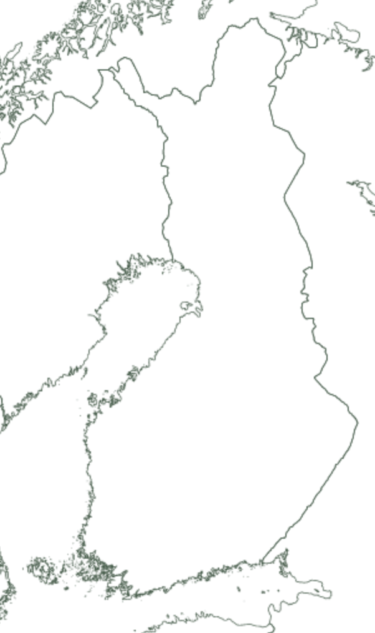
Label data consists of trains delayed between stations
Data from 2010 – 2018
514 stations
27 132 093 rows
Only passenger trains considered
End: +6 min
Mid 2: +12 min
Mid 1: +0 min
Start: +0 min
Image: Roope Tervo 2018, license CC4, Data Liikennevirasto (CC4)
Image: Roope Tervo 2018, license CC4, Data Maanmittauslaitos (CC4)
Notes:
Message: label data consists of trains delayed between stations
Length of history
Size of dataset
Passenger trains considered only
Other option as well
~10 trains per hour at busiest stations
Many stations host only few trains per day
Some stations contain only cargo traffic
Trains delayed at end station of the route (minutes reported to every station to time stamp when train passed the stations
Four train types (intercity, commuter, cargo, other)
We consider only passenger trains

Slide 9
514 stations
~10 trains per hour at busiest stations
Many stations host only few trains per day
Some stations contain only cargo traffic
Label Data
Notes:
Message: we have a little over 500 stations covering almost whole Finland

Slide 10
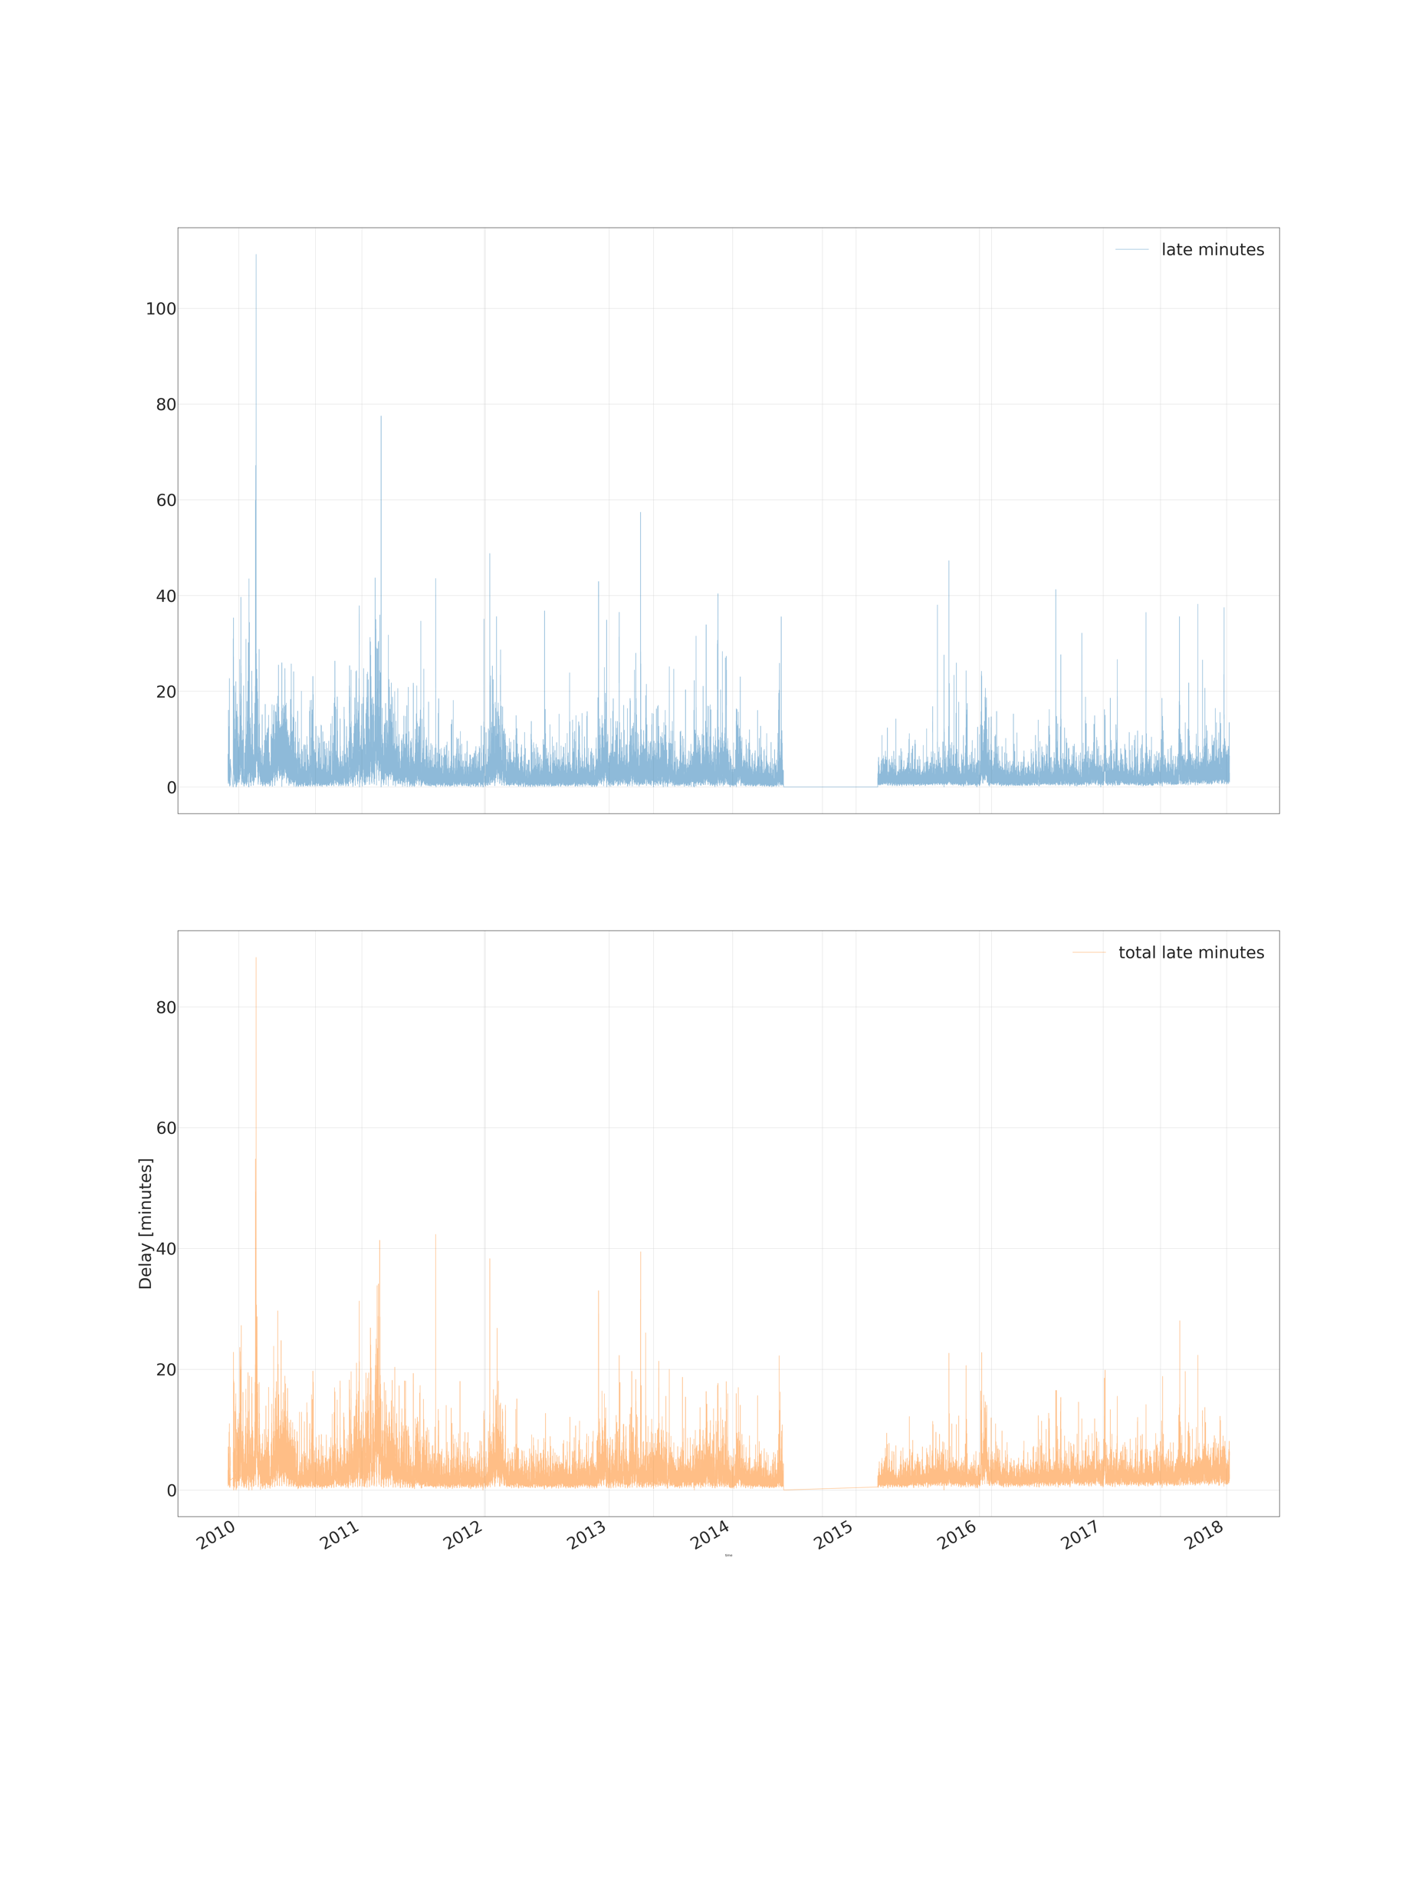
Most trains run in time
Mean delay over all stations
100
Minutes
50
0
2010
2014
2018
Notes:
Message: most of the time trains run in time but there are some very bad moments regularly

Slide 11
Most trains run in time
Mean delay over all stations
100
Minutes
50
0
2010
2014
2018
But severe delays happen quite regurarly every year
Notes:
Message: most of the time trains run in time but there are some very bad moments regularly

Slide 12
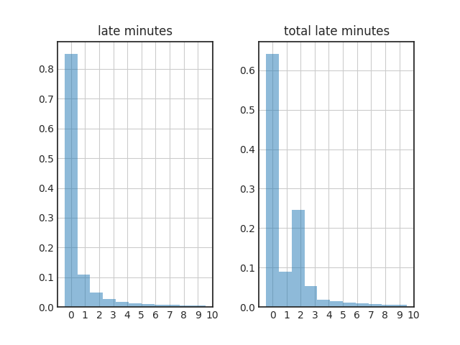
Label Data Histogram of delays, passenger trains
Notes:
Message: 65 % of all trains arrives on station exactly on time

Slide 13

Delays are time related phenomena Heatmap of delays, passenger trains, 2010
Notes:
Message: train delays are clearly time depended phenomena

Slide 14

Delays are time related phenomena Heatmap of delays, passenger trains, 2011
Notes:
Message: train delays are clearly time depended phenomena

Slide 15
Weather Observations Used as Features
19 weather observation parameters near train stations used for training:
Weather observation fetched for every train station for every hour when train has passed the station
The same weather parameters as in training fetched from Harmonie numerical weather prediction model used for prediction
Feature Data
Notes:
Message 1: for features, we gather 19 weather parameters from nearest observation stations for every hour train has arrived to the station
Message 2: we use weather observation data for training but output of NWP for predicting delays

Slide 16
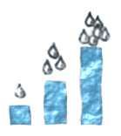
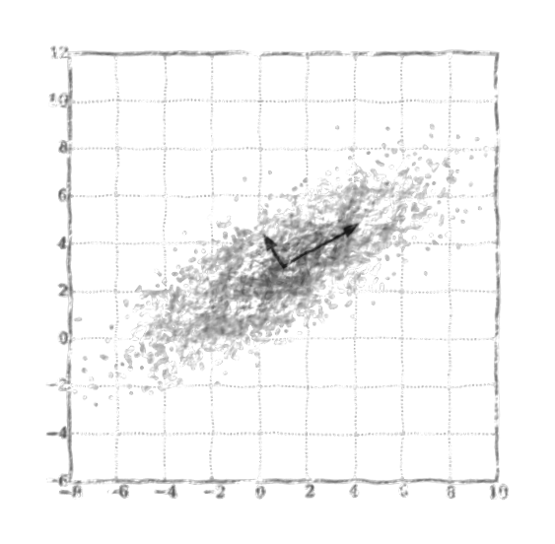
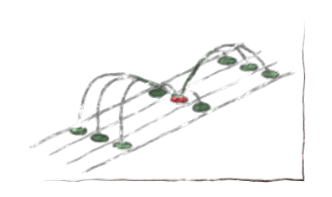
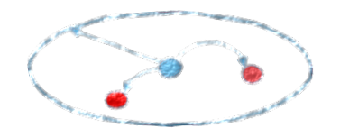
Various pre-processing methods used
Observations fetched with 100 km radius from train station using aggregation
Calculated 3h and 6h precipitation accumulation sums
Tried with and without imputation and normalisation
Tried PCA, ICA and K-Means clustering
100km
Image: Roope Tervo 2018. License: CC4-BY
Image: Roope Tervo 2018. License: CC4-BY
Image: Roope Tervo 2018. Original image: Mjanson srf. License: CC-BY-SA-3.0.
Image: Roope Tervo 2018. Original image: Nicoguaro. License: CC4-BY.
Notes:
Message: various pre-processing methods used for the features
Observations fetched with 100 km radius from train station using aggregation functions (min/max/mean/count) to minimize amount of missing values
Calculated 3h and 6h precipitation accumulation sums
Tried with and without imputation and normalisation
Tried also PCA, ICA and K-Means clustering

Slide 17
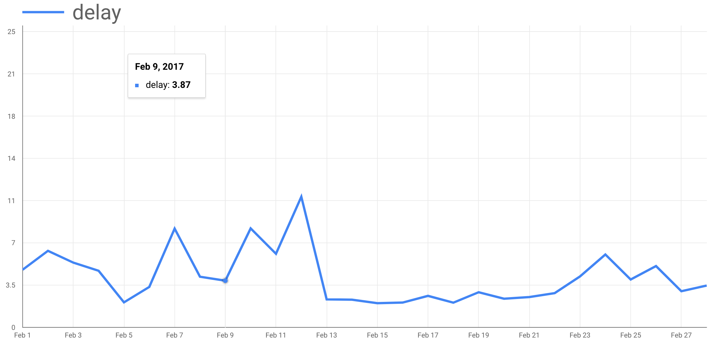
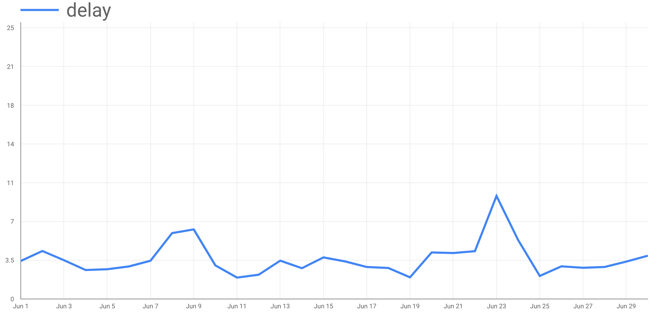
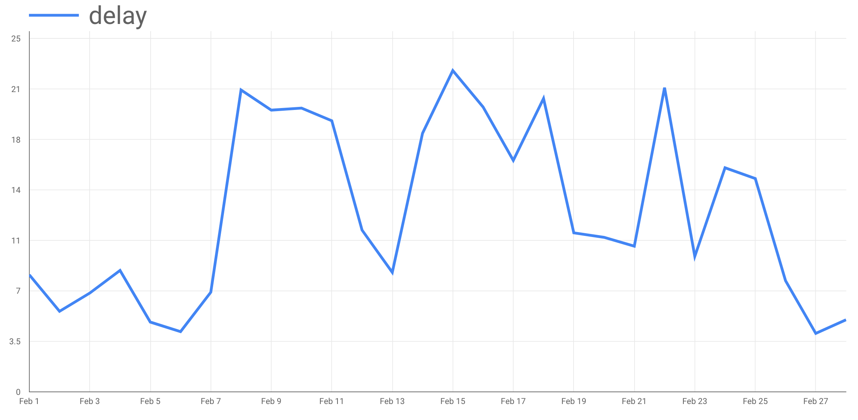
Three selected months picked out for testing performance
02/2017
06/2016
Train, validation and test data
02/2011
Rest of the dataset splitted randomly to train and validation dataset with ratio 70/30 %
Notes:
Message 1: for features, we gather 19 weather parameters from nearest observation stations for every hour train has arrived to the station
Message 2: we use weather observation data for training but output of NWP for predicting delays

Slide 18


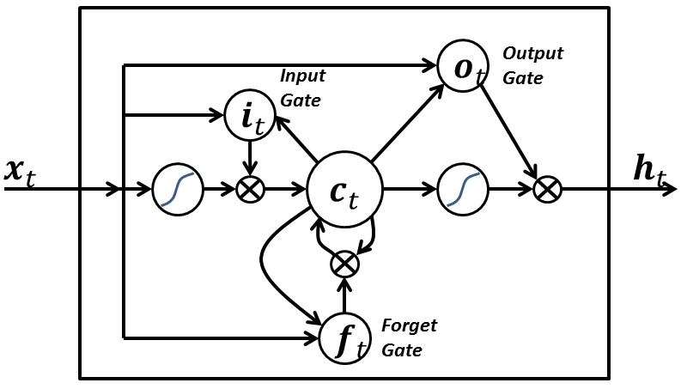
Method
Three ML methods considered
LR
RFR
LSTM
Image: CC0
Image: Venkata Jagannath. License: CC4-BY
Image: BiObserver. License: CC4-BY
Random search used for finding optimal hyper parameters of LR and RFR
Notes:
Message: three separate ML methods considered

Slide 19
Results Best results so far
LR
RMSE: NaN
MAE: NaN
RFR
RMSE: 13.55
MAE: 4.52
LSTM
RMSE: 11.38
MAE: 7.87
Didn’t converge
Image: CC0
Image: Venkata Jagannath. License: CC4-BY
Image: BiObserver. License: CC4-BY
RMSE used as main metric
Results are trade-off between MAE and RMSE
MAE tells about overall accuracy while RMSE gives more weight on large mistakes
Rail traffic operation center wants to emphasize large delays
Notes:
Message: LSTM gives the best results in terms of RMSE

Slide 20
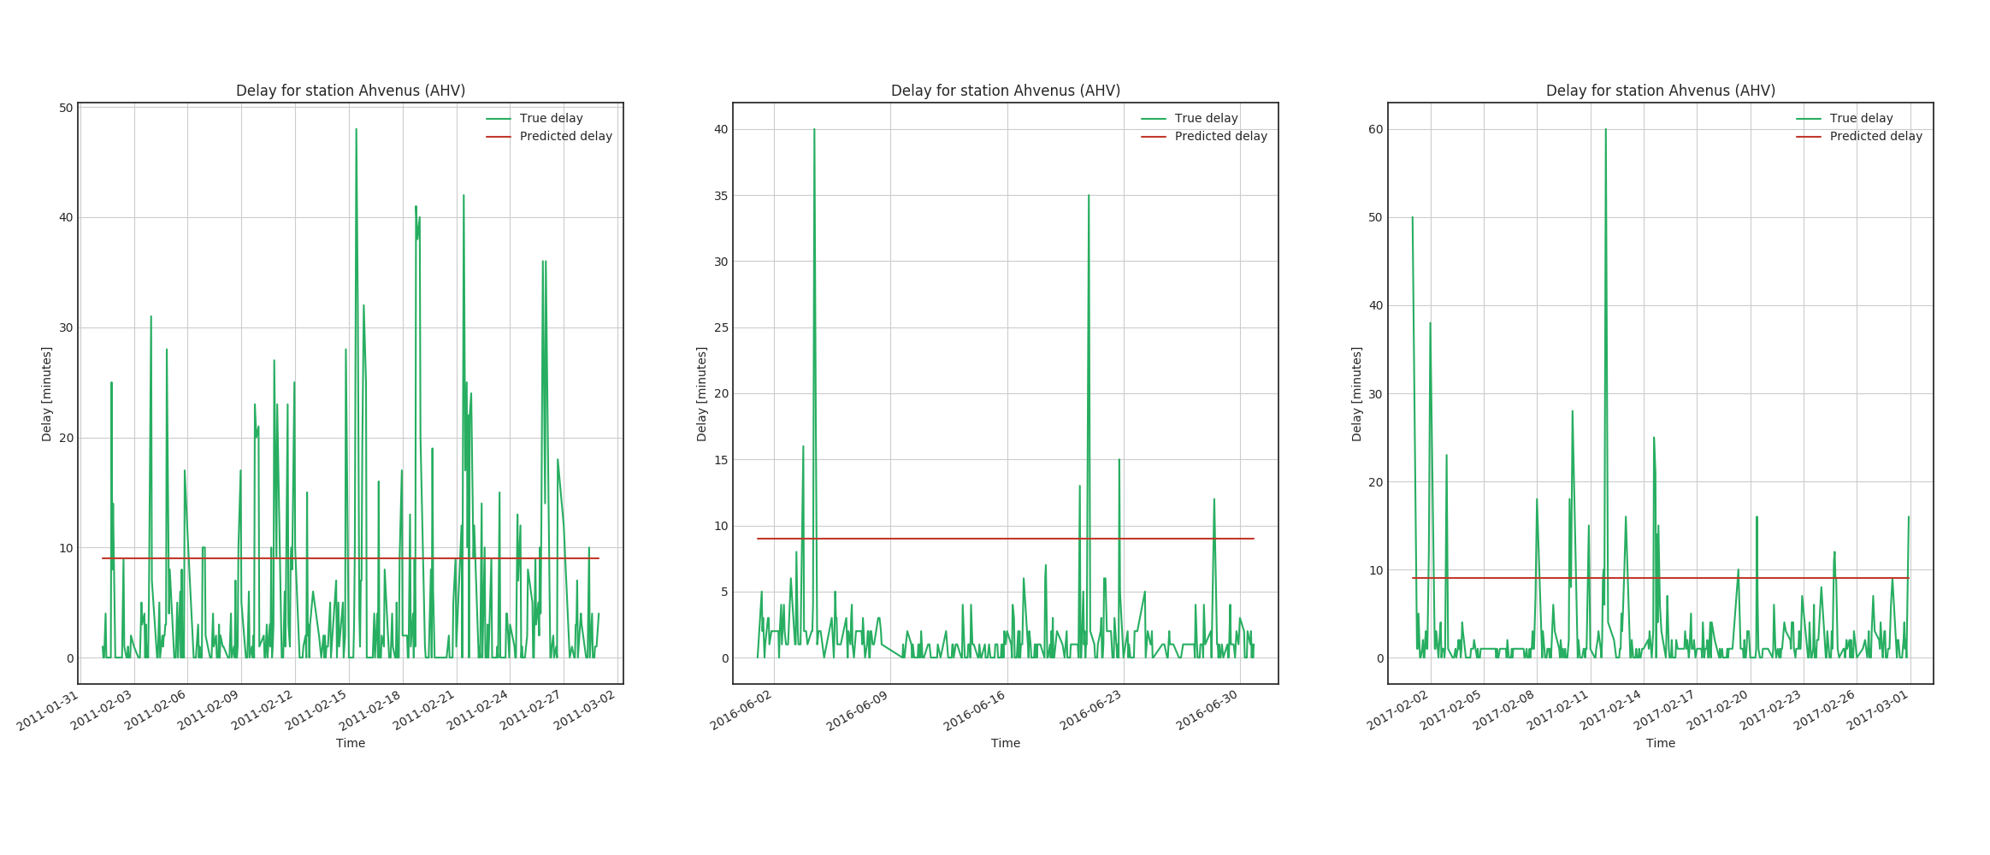
LSTM shows no real skill
Ahvenus
50
Delay (minutes)
25
0
Time 02/2018
Time 06/2016
Time 02/2017
Predicted vs. true delay, one example
Notes:
Message: LSTM gave good results in term of RMSE but shows no real skill

Slide 21
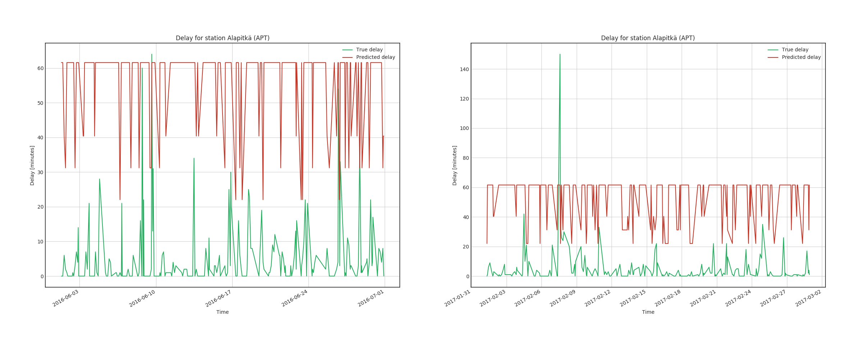
LSTM shows no real skill
Ahvenus
50
Delay (minutes)
25
0
Time 02/2018
Time 02/2017
Predicted vs. true delay, next version
Notes:
Message: LSTM gave good results in term of RMSE but shows no real skill

Slide 22
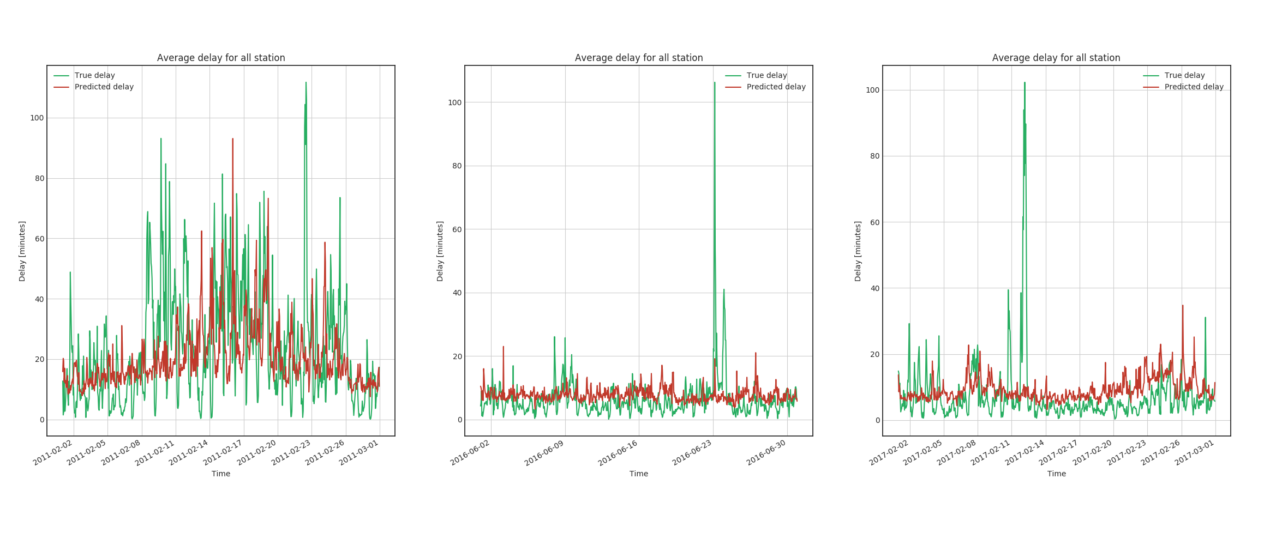
RFR works relatively well
Average over all stations
100
Delay (minutes)
50
0
Time 02/2018
Time 06/2016
Time 02/2017
Predicted vs. true delay, average over all stations
Notes:
Message: best RFR prediction followed actual observations relatively well

Slide 23
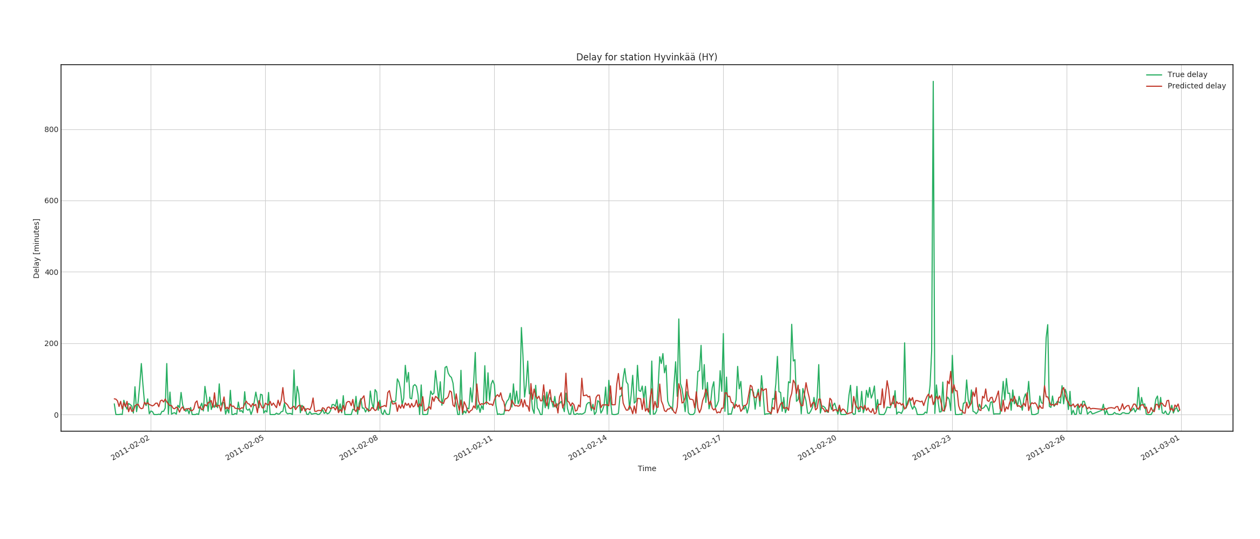
RFR works relatively well
Predicted vs. true delay, good stations
Notes:
Message: for most single stations, RFR works quite well

Slide 24
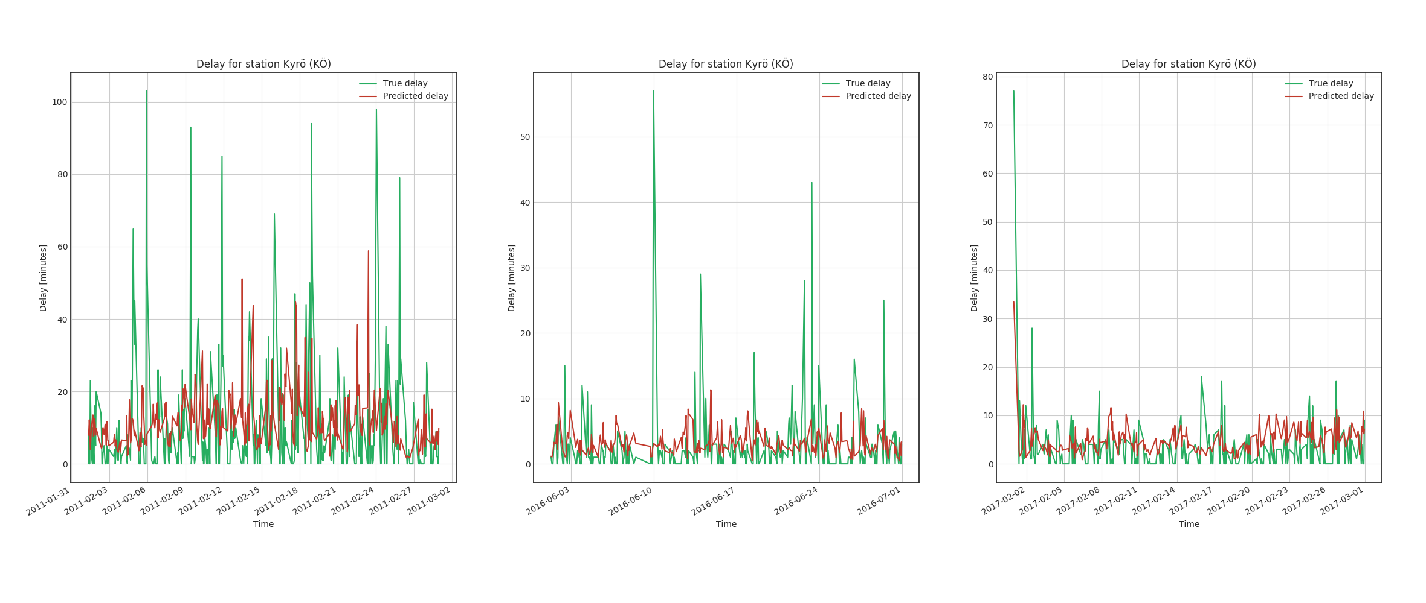
RFR works quite well for most individual stations
Kyrö
100
Delay (minutes)
50
0
Time 02/2018
Time 06/2016
Time 02/2017
Predicted vs. true delay, example of good stations
Notes:
Message: for most single stations, RFR works quite well

Slide 25
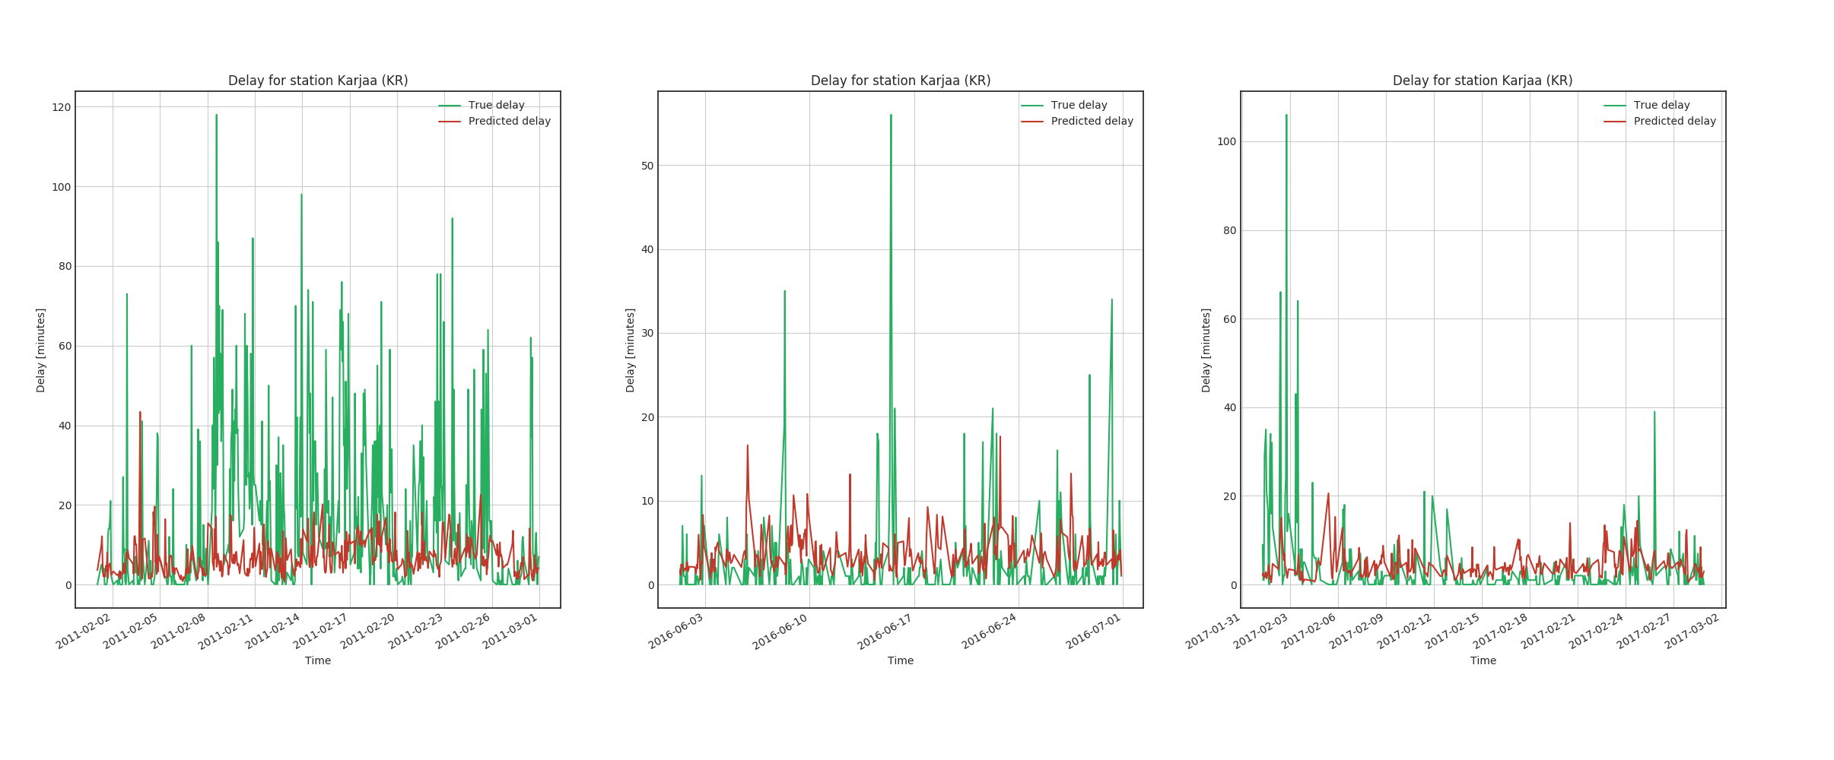
RFR don’t work for all cases
Karjaa
100
Delay (minutes)
50
0
Time 02/2018
Time 06/2016
Time 02/2017
Predicted vs. true delay, example of bad stations
Notes:
Message: there are also stations where RFR totally misses the delays

Slide 26
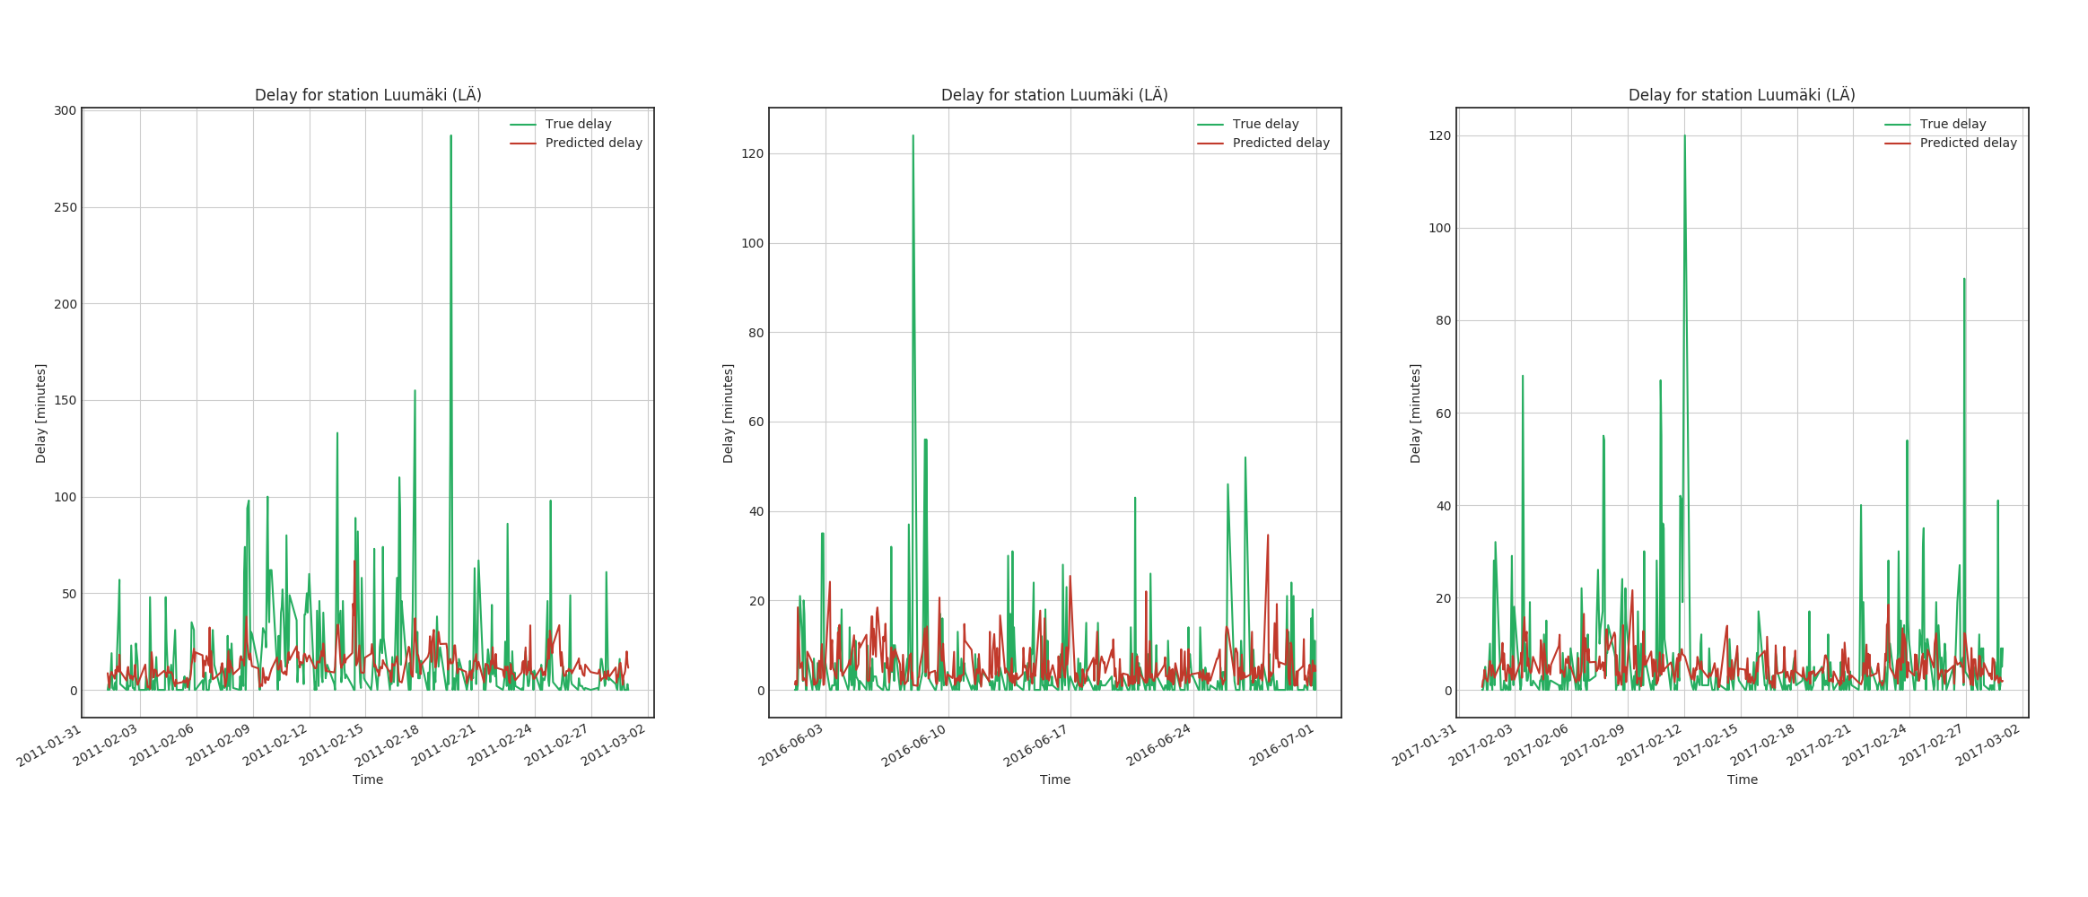
There are also stations where RFR totally misses the delays
Predicted vs. true delay, bad stations
Notes:
Message: there are also stations where RFR totally misses the delays

Slide 27
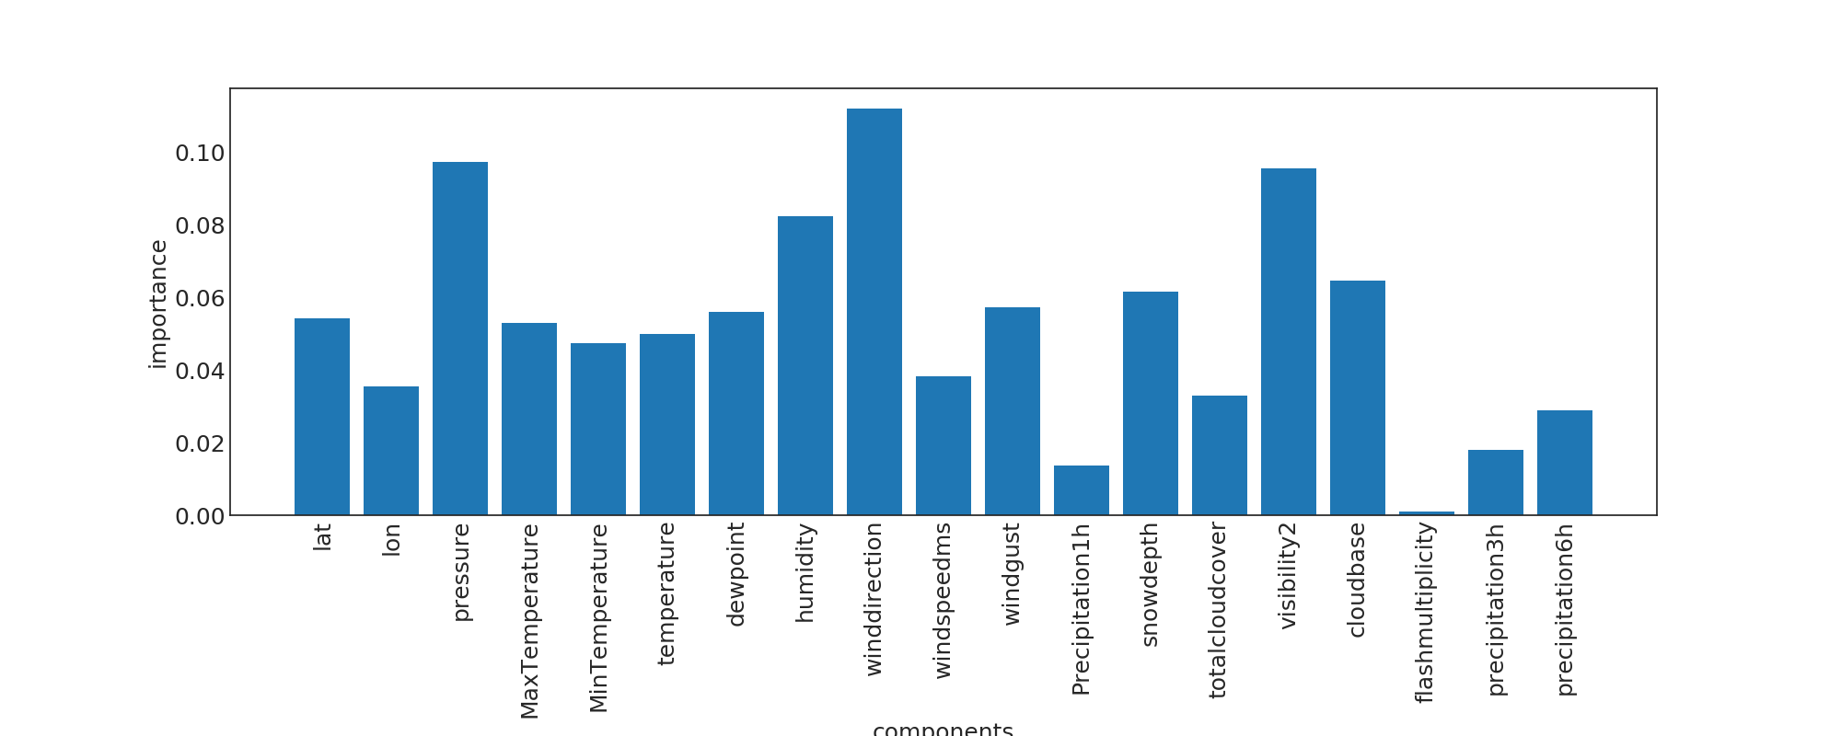
Based on RFR, two out of 19 features provided no value
Notes:
Message: based on RFR, two out of 19 features provided no value
6h precipitation sum
Lightning density
humidity

Slide 28
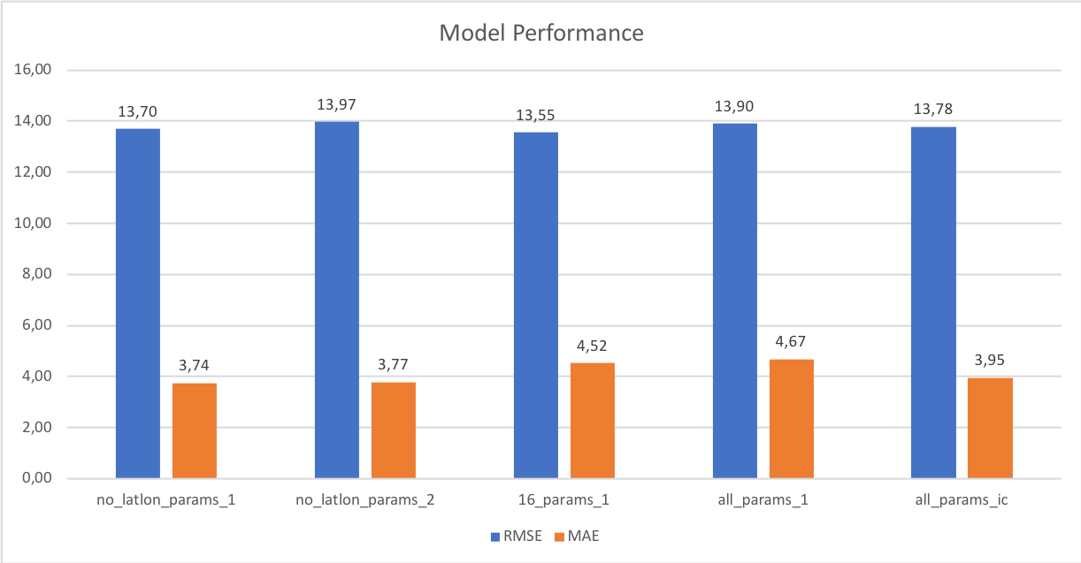
Different setups changed output only slightly
Notes:
Message: different setups changed output only very little

Slide 29
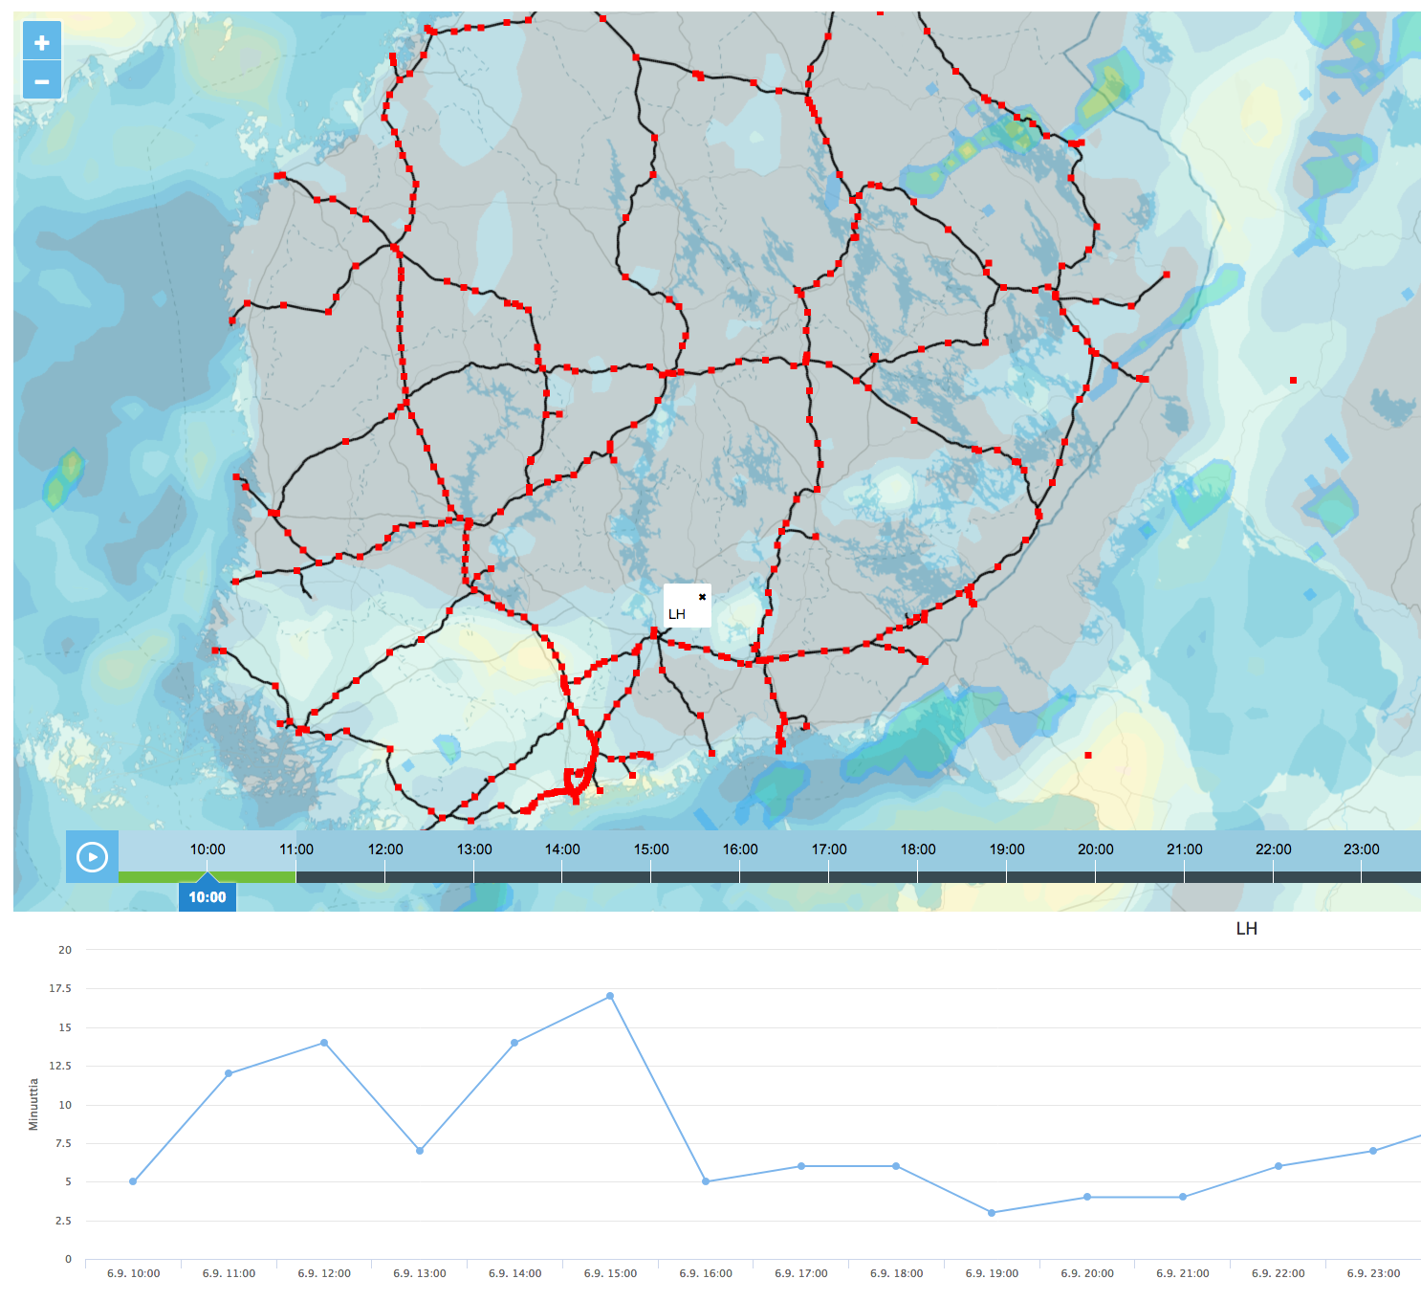
User Interface
Predictions are delivered to end users via web interface
Notes:
Message: end predictions are delivered to end users via web interface

Slide 30
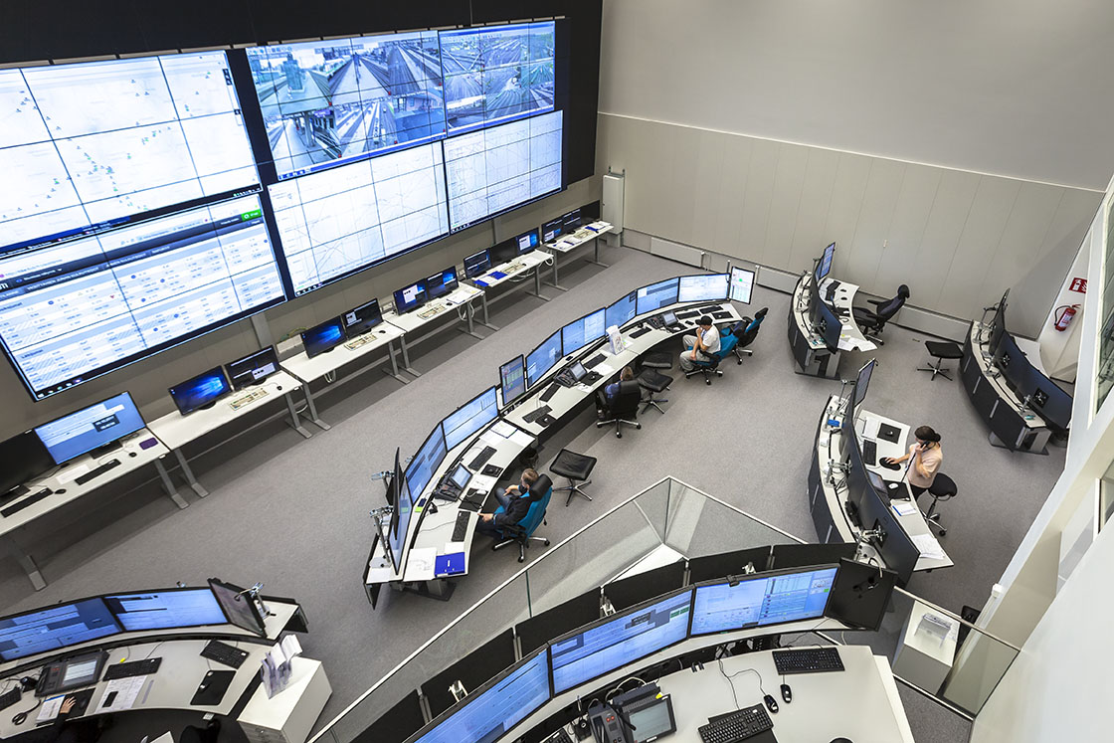
Train Delays Can Be Predicted
RFR gives the best average prediction
…although its performance is not steady
Image: Solita Oy
Notes:
Message: end predictions are delivered to end users via web interface

Slide 31
Roope Tervo
roope.tervo@fmi.fi
http://roopetervo.com

Slide 32





Tools
Labels (train statistics) got as csv
Features (weather observations) fetched from http data server
Labels and features stored in Google Big Query
Prediction model implemented with SciKit (LR, RFR) and TensorFlow (LSTM)
Spark used for distribution
Fetching data
Possibly also for tuning LSTM
Notes:
Message: several different tools was used

Slide 33
Delay data:
https://www.dropbox.com/s/oxpqnj2a6l1revn/gratu%202010-14.zip?dl=0
https://www.dropbox.com/s/wuogtxj31ans5fd/2015-18.zip?dl=0
Delay + feature data:
https://www.dropbox.com/sh/efuotuu1slwqb00/AAB344cobWFACiVScAkQZtWea?dl=0
Data
Notes:
Message: you can download the data
Caution processes
Bayesian methods
Correlations

